Slide 1


Foundations of
Scientific Computing
(SciComp 101)
Dave Biersach
dbiersach@bnl.gov
Session 16
Linear Equations

Slide 2
Session 16 – Goals
Review real and complex vectors, including addition, scalar multiplication, and dot product
Review real and complex matrices, including matrix inversion, transpose, adjoint, and inner product
Identify and use diagonal, symmetric, Identity, Hermitian, and Unitary matrices
Understand basis sets, transition matrices, and the Hadamard matrix
Appreciate the eigenvectors and eigenvalues of a matrix

Slide 3
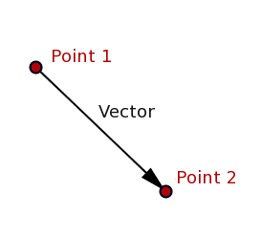
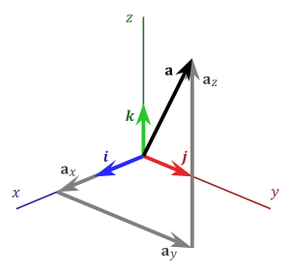
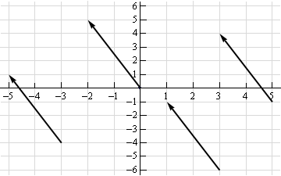
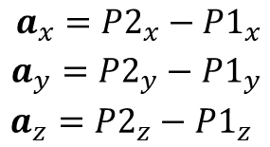
What is a vector?
$a_{x} a_{y} a_{z}$ are the components of
vector$\overset{⃑}{a}$

Slide 4
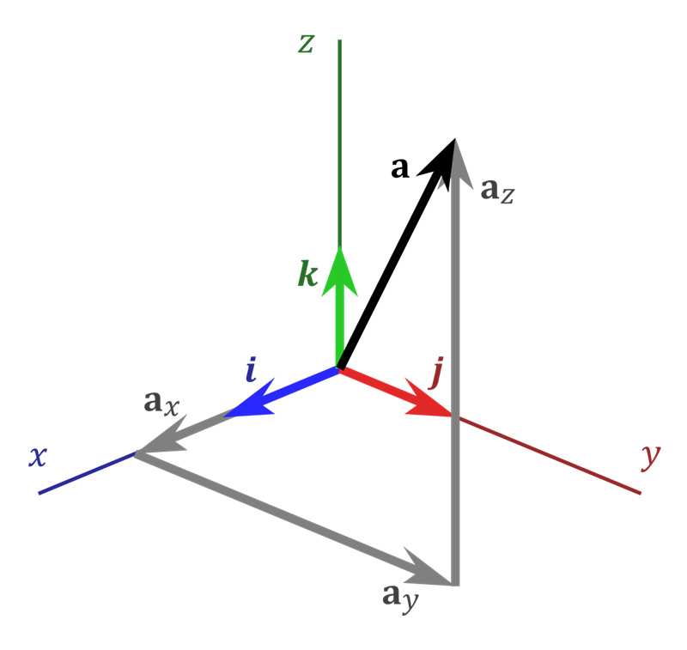


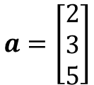






Real Vectors
$$Basis Vectors: \hat{i},\hat{j},\hat{k}$$
A vector is any “directed”
line segment
$$(2, 3, 5)$$
The hat indicates a Unit Vector
(length is 1)
$$Components:a_{x},a_{y},a_{z}$$
How much of each basis makes up $\vec{a}$
Boldface
$$\vec{a}=a_{x}\hat{i}+a_{y}\hat{j}+a_{z}\hat{k}=a$$
Vectors are basis independent,
but the components are not
$$\vec{a}=2\hat{i}+3\hat{j}+5\hat{k}$$
$$a=\left[\begin{matrix}2 \\ 3 \\ 5\end{matrix}\right]$$
A “column”
vector
$$a=\left[\begin{matrix}2 & 3 & 5\end{matrix}\right]$$
$$a=\left\langle 2, 3, 5\right\rangle$$
A “row” vector

Slide 5

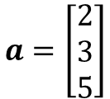


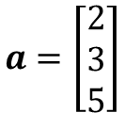
Real Vectors
$$a=\left[\begin{matrix}2 & 3 & 5\end{matrix}\right]$$
A vector is a “directed”
line segment
$$(2, 3, 5)$$
May seem like 1 row x 3 columns
$$a=\left[\begin{matrix}2 \\ 3 \\ 5\end{matrix}\right]$$
May seem like 3 rows x 1 column
But… a vector is strictly a one-dimensional (1D) object
$$Norm:\left\|a\right\|= \sqrt{a_{x}^{2}+a_{y}^{2}+a_{z}^{2}}$$
$$\vec{a}=2\hat{i}+3\hat{j}+5\hat{k}$$
$$a=\left[\begin{matrix}2 \\ 3 \\ 5\end{matrix}\right]$$
A “column”
vector
In basis $\hat{i},\hat{j},\hat{k}$
$$a=\left\langle 2, 3, 5\right\rangle$$

Slide 6
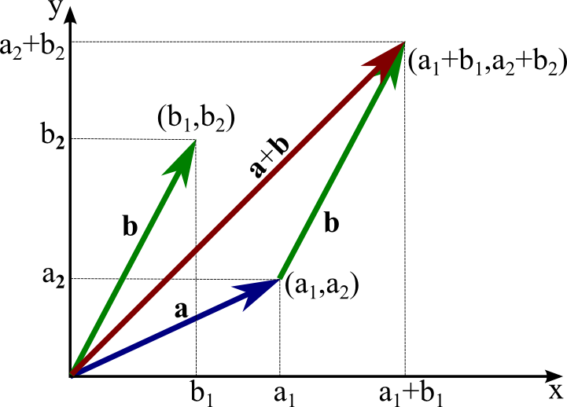
Real Vectors – Addition (Vector + Vector)
$$a=a_{1}\hat{i}+a_{2}\hat{j}$$
$$b=b_{1}\hat{i}+b_{2}\hat{j}$$
$$a+b=\left(a_{1}+b_{1}\right)\hat{i}+\left(a_{2}+b_{2}\right)\hat{j}$$

Slide 7
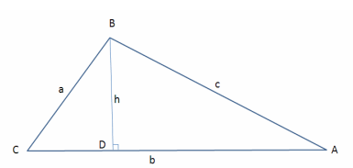
Real Vectors – Dot Product (Vector $⋅$Vector)
In $Δ BCD$:
$$\cos{C=}\frac{adj}{hyp}=\frac{CD}{a}→CD=a\cos{C}$$
$$\sin{C}=\frac{opp}{hyp}=\frac{BD}{a}→BD=a\sin{C}$$
In $Δ ABC$:
$$AD=b−CD=b−a\cos{C}$$
In $Δ ABD$:
Law of Cosines
$$c^{2}={AD}^{2}+{BD}^{2}$$
The square of a side of a triangle equals the sum of the squares of the remaining sides minus twice the product of those sides and the cosine of the angle between them
$$c^{2}={\left(b−a\cos{C}\right)}^{2}+{\left(a\sin{C}\right)}^{2}$$
1
$$c^{2}=a^{2}\left(\sin^{2}{C}+\cos^{2}{C}\right)+b^{2}−2ab\cos{C}$$
$$c^{2}=a^{2}+b^{2}−2ab\cos{C}$$

Slide 8
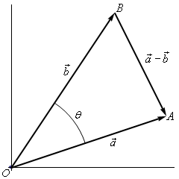
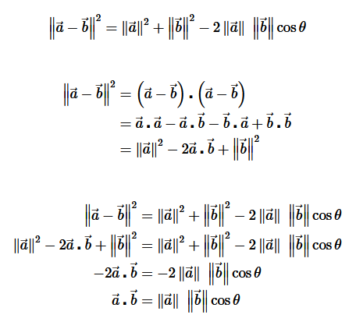
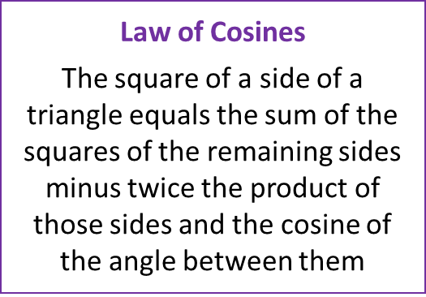
Real Vectors – Dot Product (Vector $⋅$Vector)

Slide 9
Real Vectors – Dot Product (Vector $⋅$Vector)

Slide 10
Real Vectors – Dot Product (Vector $⋅$Vector)

Slide 11

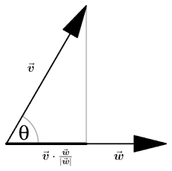
Real Vectors – Dot Product (Vector $⋅$Vector)
$$\vec{v}⋅\vec{w}=\left\|\vec{v}\right\|\left\|\vec{w}\right\|cos{θ}$$
$$\cos{θ}=\frac{\vec{v}⋅\vec{w}}{\left\|\vec{v}\right\|\left\|\vec{w}\right\|}$$
$$θ=\cos^{−1}\left(\frac{\vec{v}⋅\vec{w}}{\left\|\vec{v}\right\|\left\|\vec{w}\right\|}\right)$$
$$\left(\vec{v},\vec{w}\right)=\vec{v}⋅\vec{w}=\left\|\vec{v}\right\|\left\|\vec{w}\right\|\cos{θ}$$
← Dot product (Euclidean)
$$\left(\vec{v},\vec{w}\right)=\vec{v}⋅\vec{w}=\left\|\vec{v}\right\|\left\|\vec{w}\right\|$$
← If parallel $\left(θ=0\right)$
$$\left(\vec{v},\vec{w}\right)=\vec{v}⋅\vec{w}=0$$
← If perpendicular $\left(θ=\frac{π}{2}\right)$

Slide 12
Real Vectors – Dot Product (Vector $⋅$Vector)
Implicit Summation
For generalized
real vectors
(not necessarily Euclidean 2D)
$$\left(v,w\right)=v⋅w=v_{1}w_{1}+v_{2}w_{2}{+v}_{n}w_{n}$$
← Inner product (produces a scalar)
$$\left(v,v\right)=v⋅v=v_{1}v_{1}+v_{2}v_{2}{+v}_{n}v_{n}={\left\|v\right\|}^{2}$$
$$\left\|v\right\|=\sqrt{v⋅v}$$
The norm of a real vector is the square root of its own inner product

Slide 13
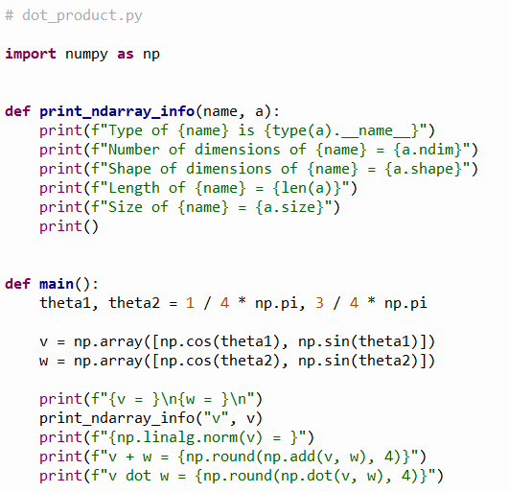



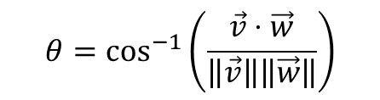

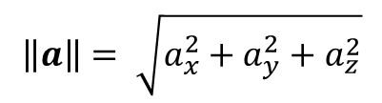





Open dot_product.py
$$v=\left[\begin{matrix}0.7071 \\ 0.7071\end{matrix}\right]$$
X
Y
$$\vec{w}$$
$$\vec{v}$$
$$\frac{3}{4}π$$
$$θ_{2}$$
$$θ_{1}$$
$$\frac{1}{4}π$$
⑥
$$\left(1,0\right)$$
$$w=\left[\begin{matrix}−0.7071 \\ 0.7071\end{matrix}\right]$$
X
Y
①
$$\left\|a\right\|= \sqrt{a_{x}^{2}+a_{y}^{2}+a_{z}^{2}}$$
②
③
④
$$θ=\cos^{−1}\left(\frac{\vec{v}⋅\vec{w}}{\left\|\vec{v}\right\|\left\|\vec{w}\right\|}\right)$$
⑤
⑦
⑧
⑨

Slide 14
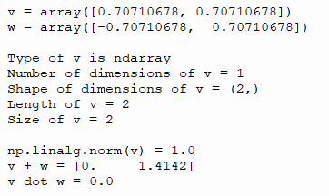

Run dot_product.py
$$v=\left[\begin{matrix}0.7071 \\ 0.7071\end{matrix}\right]$$
X
Y
①
$$\vec{w}$$
$$\vec{v}$$
$$\frac{3}{4}π$$
$$θ_{2}$$
$$θ_{1}$$
$$\frac{1}{4}π$$
②
$$\left(1,0\right)$$
③
④
⑤
$$w=\left[\begin{matrix}−0.7071 \\ 0.7071\end{matrix}\right]$$
X
Y
⑥
A vector is a one-dimensional object
$$\left\|a\right\|= \sqrt{a_{x}^{2}+a_{y}^{2}+a_{z}^{2}}$$
Length is the number of rows, and size is the total number of components
A vector having its tip on the unit circle has a norm (magnitude) of 1
$$θ=\cos^{−1}\left(\frac{\vec{v}⋅\vec{w}}{\left\|\vec{v}\right\|\left\|\vec{w}\right\|}\right)$$
Perpendicular (orthogonal) vectors have a zero dot product since $\cos^{−1}\left(0\right)={90}^{°}$

Slide 15
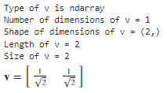
Check dot_product.py
len() only returns the number of items in the
1st dimension of an np.ndarray
$v$ is a vector with two elements, but is still just a 1-D object
Notice the comma with nothing after it

Slide 16
Real Vectors – Dot Product (Vector $⋅$Vector)
Each of these unit vectors lies entirely along itself
$$\left\{\begin{matrix}\hat{i}⋅\hat{i}=\left\|\hat{i}\right\|\left\|\hat{i}\right\|\cos{0}=\left(1\right)\left(1\right)\left(1\right)=1 \\ \hat{j}⋅\hat{j}=\left\|\hat{j}\right\|\left\|\hat{j}\right\|\cos{0}=\left(1\right)\left(1\right)\left(1\right)=1 \\ \hat{k}⋅\hat{k}=\left\|\hat{k}\right\|\left\|k\right\|\cos{0}=\left(1\right)\left(1\right)\left(1\right)=1\end{matrix}\right.$$
$$\left\{\begin{matrix}\hat{i}⋅\hat{j}=\left\|\hat{i}\right\|\left\|\hat{j}\right\|\cos{90}=\left(1\right)\left(1\right)\left(0\right)=0 \\ \hat{i}⋅\hat{k}=\left\|\hat{i}\right\|\left\|\hat{k}\right\|\cos{90}=\left(1\right)\left(1\right)\left(0\right)=0 \\ \hat{j}⋅\hat{k}=\left\|\hat{j}\right\|\left\|k\right\|\cos{90}=\left(1\right)\left(1\right)\left(0\right)=0\end{matrix}\right.$$
No part of these unit vectors lies along any other
$\hat{i},\hat{j},\hat{k}$ are the canonical orthonormal basis vectors in $ℝ^{3}$

Slide 17
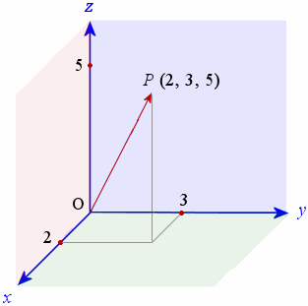
Real Vectors – Dot Product (Vector $⋅$Vector)
$$\vec{v}⋅\hat{i}=\left(v_{x}\hat{i}+v_{y}\hat{j} +v_{z}\hat{k}\right)⋅\hat{i}$$
$v_{n}$= Vector Components
aka "scalars"
$$\vec{v}$$
$$=v_{x}\left(\hat{i}⋅\hat{i}\right)+v_{y}\left(\hat{i}⋅\hat{j}\right)+v_{z}\left(\hat{i}⋅\hat{k}\right)$$
$$=v_{x}\left(1\right)+v_{y}\left(0\right)+v_{z}\left(0\right)$$
$$=v_{x}$$
$$\vec{v}⋅\hat{i}=v_{x}$$
We can get the individual components of a real vector by forming the dot product with each of its orthonormal basis vectors
$$\vec{v}⋅\hat{j}=v_{y}$$
$$\vec{v}⋅\hat{k}=v_{z}$$

Slide 18
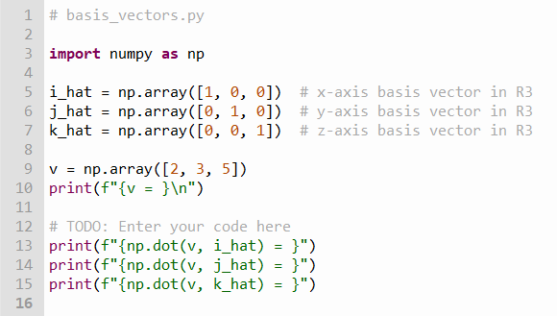
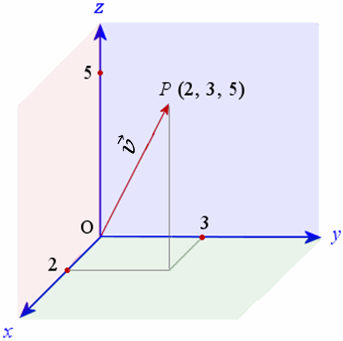



Edit basis_vectors.py
①
②
$$\vec{v}⋅\hat{i}=v_{x}$$
$$\vec{v}⋅\hat{j}=v_{y}$$
$$\vec{v}⋅\hat{k}=v_{z}$$

Slide 19

Run basis_vectors.py
①
②
$$\vec{v}⋅\hat{i}=v_{x}$$
$$\vec{v}⋅\hat{j}=v_{y}$$
$$\vec{v}⋅\hat{k}=v_{z}$$

Slide 20
Matrix Nomenclature
A “matrix” in NumPy is represented as vectors of vectors
A matrix can hold any number of elements (in each dimension), but all elements must be of the same data type, such as int or float
Matrix elements are accessed by their index numbers, which starts at zero and correspond to each dimension
Matrix nomenclature
In mathematics, a matrix size is written as (Rows x Columns)
In NumPy a matrix (aka a ndarray) is written using commas instead of multiplication crosses, and using square brackets instead of parenthesis: [Row, Column]
Example: the NumPy array [5,7] has 5 rows and 7 columns

Slide 21
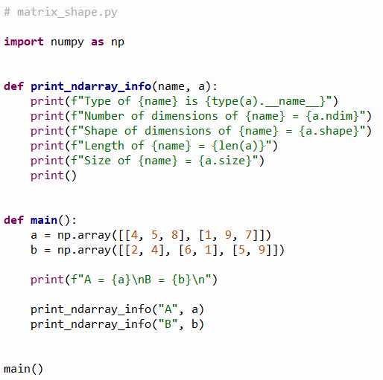

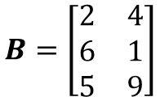


Open matrix_shape.py
Matrix names are written in boldface and Capitalized
$$A=\left[\begin{matrix}4 & 5 & 8 \\ 1 & 9 & 7\end{matrix}\right]$$
2 rows by 3 cols
$$2×3$$
②
We are creating 2-D arrays
③
④
$$B=\left[\begin{matrix}2 & 4 \\ 6 & 1 \\ 5 & 9\end{matrix}\right]$$
⑤
⑥
3 rows by 2 cols
$$3×2$$
①

Slide 22
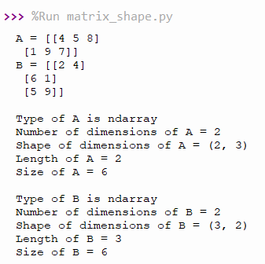


Run matrix_shape.py
Matrices can differ in shape but agree in size
Matrix names are written in boldface and Capitalized
①
②
③
$$A=\left[\begin{matrix}4 & 5 & 8 \\ 1 & 9 & 7\end{matrix}\right]$$
④
⑤
2 rows by 3 cols
$$2×3$$
We are creating 2-D arrays
⑥
⑦
⑧
$$B=\left[\begin{matrix}2 & 4 \\ 6 & 1 \\ 5 & 9\end{matrix}\right]$$
⑨
3 rows by 2 cols
$$3×2$$
Length is the number of rows, and size is the total number of components

Slide 23
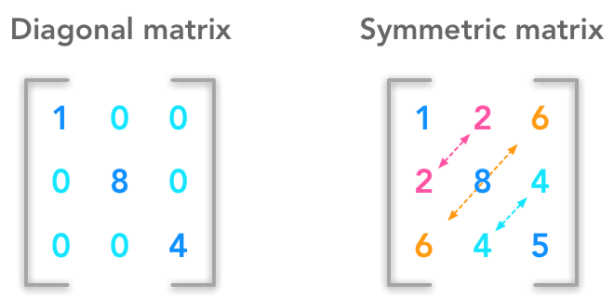
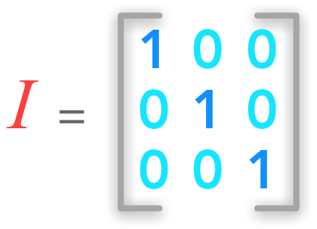
Matrix Nomenclature
Identity Matrix

Slide 24
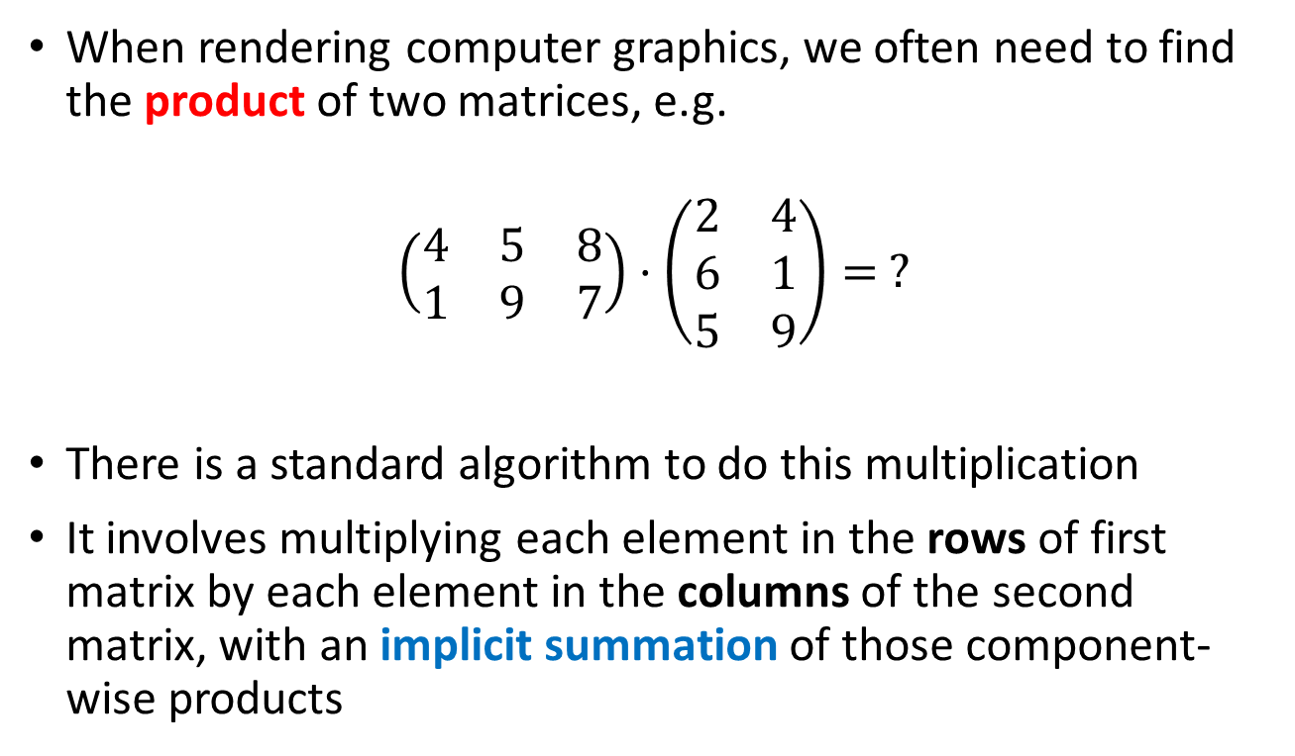
Matrix Multiplication
When rendering computer graphics, we often need to find the product of two matrices, e.g.
$$\left(\begin{matrix}4 & 5 & 8 \\ 1 & 9 & 7\end{matrix}\right)⋅\left(\begin{matrix}2 & 4 \\ 6 & 1 \\ 5 & 9\end{matrix}\right)= ?$$
There is a standard algorithm to do this multiplication
It involves multiplying each element in the rows of first matrix by each element in the columns of the second matrix, with an implicit summation of those component-wise products

Slide 25
Matrix Multiplication
In order to multiply two matrices together, the number of columns in matrix A must equal the number of rows in matrix B (Cols A = Rows B)
The resulting matrix will have as many rows as there were rows in matrix A, and as many columns as there were columns in matrix B (Rows A x Cols B)

Slide 26
Matrix Multiplication
Example
Matrix A has dimension (2 x 3) = 2 rows, 3 columns
Matrix B has dimension (3 x 2) = 3 rows, 2 columns
$$\left(\begin{matrix}4 & 5 & 8 \\ 1 & 9 & 7\end{matrix}\right)⋅\left(\begin{matrix}2 & 4 \\ 6 & 1 \\ 5 & 9\end{matrix}\right)= ?$$
The inner values must match!
A
B
(2 x 3) $⋅$ (3 x 2)
The “shapes” of matrices A and B
A
B
The outer values will be
the shape of the final
matrix product!

Slide 27
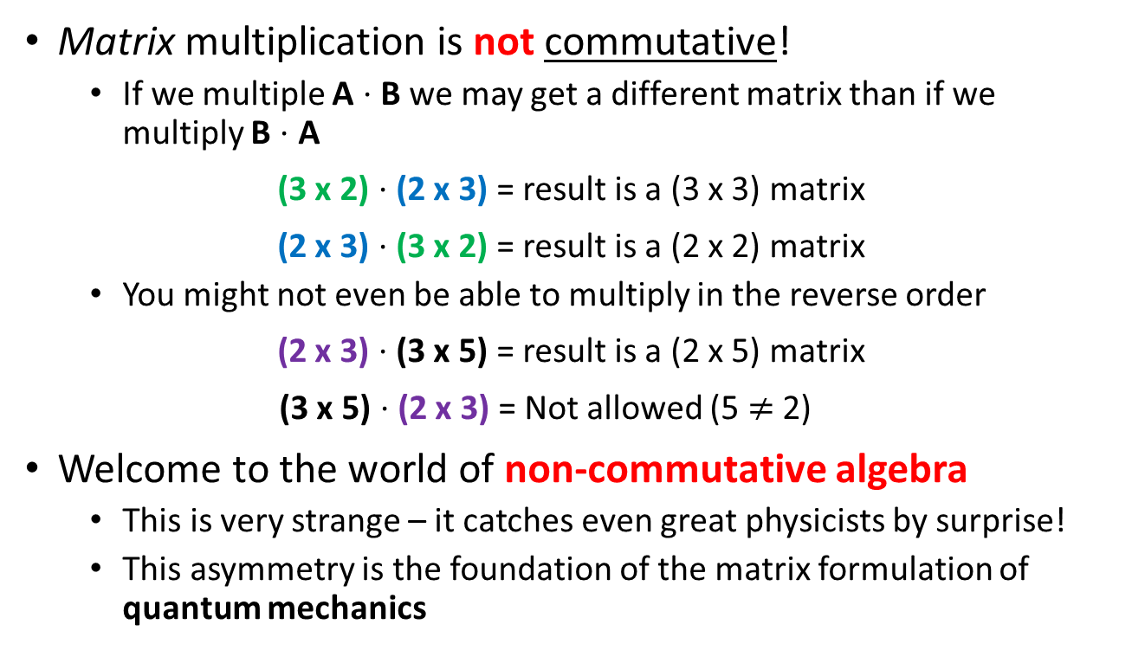
Matrix Multiplication
Matrix multiplication is not commutative!
If we multiple A $⋅$ B we may get a different matrix than if we multiply B $⋅$ A
(3 x 2) $⋅$ (2 x 3) = result is a (3 x 3) matrix
(2 x 3) $⋅$ (3 x 2) = result is a (2 x 2) matrix
You might not even be able to multiply in the reverse order
(2 x 3) $⋅$ (3 x 5) = result is a (2 x 5) matrix
(3 x 5) $⋅$ (2 x 3) = Not allowed (5 $≠$ 2)aaa
Welcome to the world of non-commutative algebra
This is very strange – it catches even great physicists by surprise!
This asymmetry is the foundation of the matrix formulation of quantum mechanics

Slide 28
Matrix Multiplication
The algorithm is simple but tedious for A $∙$ B = C
Sum the product of every element in each row of matrix A and the corresponding element in each column of matrix B
That sum becomes just one element in new matrix C
Continue this process for all rows in matrix A
Every row in A gets multiplied by every column in B
The resulting matrix will have dimensions (Rows A x Cols B)

Slide 29
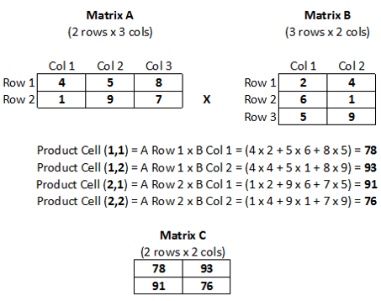
Matrix Multiplication

Slide 30
Matrix Multiplication

Slide 31
Matrix Multiplication

Slide 32
Matrix Multiplication

Slide 33
Matrix Multiplication

Slide 34
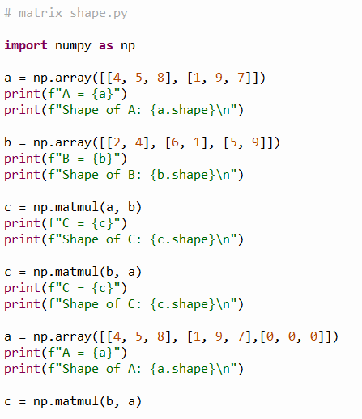
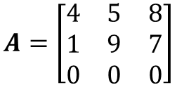


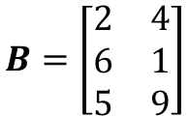


Open matrix_multiplication.py
①
$$A=\left[\begin{matrix}4 & 5 & 8 \\ 1 & 9 & 7\end{matrix}\right]$$
$$B=\left[\begin{matrix}2 & 4 \\ 6 & 1 \\ 5 & 9\end{matrix}\right]$$
②
③
$$C=A⋅B$$
④
$$C=B⋅A$$
$$A=\left[\begin{matrix}4 & 5 & 8 \\ 1 & 9 & 7 \\ 0 & 0 & 0\end{matrix}\right]$$
⑤
⑥
$$C=B⋅A$$

Slide 35
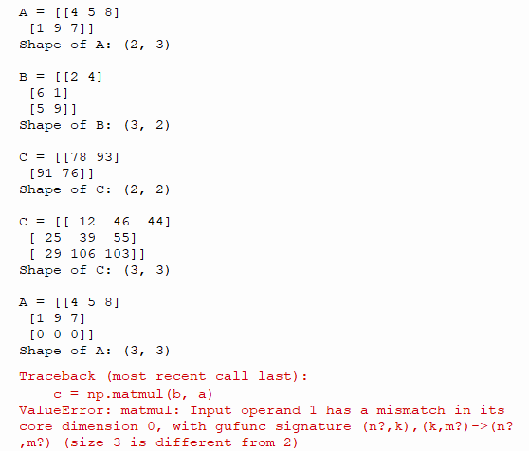


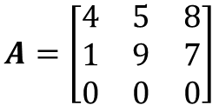


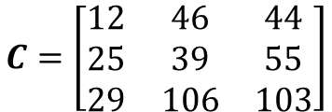
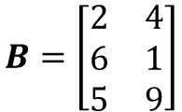




Run matrix_multiplication.py
①
$$A=\left[\begin{matrix}4 & 5 & 8 \\ 1 & 9 & 7\end{matrix}\right]$$
$$B=\left[\begin{matrix}2 & 4 \\ 6 & 1 \\ 5 & 9\end{matrix}\right]$$
②
$$C=A⋅B$$
$$\left(2×3\right)⋅\left(3×2\right)$$
$$C=\left[\begin{matrix}78 & 93 \\ 91 & 76\end{matrix}\right]$$
③
$$C=\left[\begin{matrix}12 & 46 & 44 \\ 25 & 39 & 55 \\ 29 & 106 & 103\end{matrix}\right]$$
$$C=B⋅A$$
$$\left(3×2\right)⋅\left(2×3\right)$$
④
$$A=\left[\begin{matrix}4 & 5 & 8 \\ 1 & 9 & 7 \\ 0 & 0 & 0\end{matrix}\right]$$
⑤
$$C=B⋅A$$
$$\left(3×2\right)⋅\left(3×3\right)$$
⑥

Slide 36
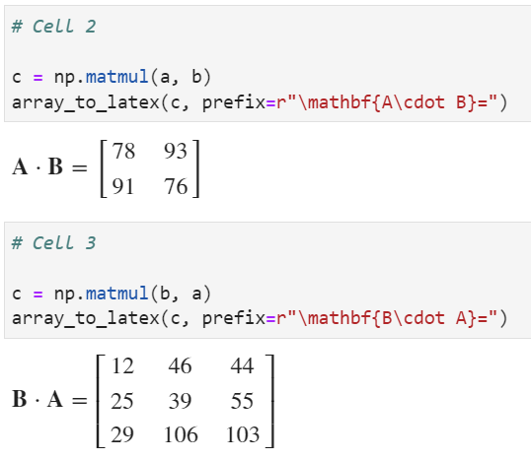
Run Cells 2 & 3 – matrix_algebra.ipynb
①
②
See slide #34
③
$$3×2∙2×3=3×3$$

Slide 37
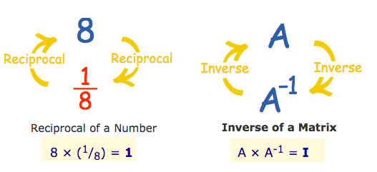















Matrix Inversion
Non-square matrices are not directly invertible
Matrix “Division”
Solve System of Linear Equations
$$\frac{A}{B}=A⋅B^{−1}$$
$$A⋅x=B$$
$$A^{−1}⋅\left(A⋅x\right)=A^{−1}⋅B$$
$$A$$
$$x$$
$$B$$
$$4r+7s=47$$
$$\left[\begin{matrix}4 & 7 \\ 3 & −5\end{matrix}\right]\left[\begin{matrix}r \\ s\end{matrix}\right]=\left[\begin{matrix}47 \\ −16\end{matrix}\right]$$
$$\left(A^{−1}⋅A\right)⋅x=A^{−1}⋅B$$
$$3r−5s=−16$$
$$I⋅x=A^{−1}⋅B$$
$$x=A^{−1}⋅B$$
$$4(3)+7(5)=47$$
$$\left[\begin{matrix}4 & 7 \\ 3 & −5\end{matrix}\right]\left[\begin{matrix}3 \\ 5\end{matrix}\right]=\left[\begin{matrix}47 \\ −16\end{matrix}\right]$$
$$3(3)−5(5)=−16$$

Slide 38
Determinant of a Matrix
In linear algebra, the determinant is a value that can be computed from the elements of a square matrix
The determinant can be used:
To solve a system of linear equations when those equations are represented by a matrix
To find the Jacobian of the matrix of all first-order partial derivatives of a vector-valued function
To calculate the characteristic polynomial of a matrix which is essential for eigenvalue problems
To express the signed n-dimensional volumes of n-dimensional parallelepipeds in analytic geometry

Slide 39
Determinant of a Matrix
Calculating the Determinant of a 2 x 2 Matrix
$$A=\left[\begin{matrix}a_{11} & a_{12} \\ a_{21} & a_{22}\end{matrix}\right]→\det{A}=\left|A\right|=\left|\begin{matrix}a_{11} & a_{12} \\ a_{21} & a_{22}\end{matrix}\right|$$
$$det\left[\begin{matrix}a_{11} & a_{12} \\ a_{21} & a_{22}\end{matrix}\right]=a_{11}∙a_{22}−a_{12}∙a_{21}$$
$$det\left[\begin{matrix}a_{11} & a_{12} \\ a_{21} & a_{22}\end{matrix}\right]=a_{11}∙a_{22}−a_{12}∙a_{21}$$

Slide 40
Determinant of a Matrix
Calculating the Determinant of a 2 x 2 Matrix
$$A=\left[\begin{matrix}a_{11} & a_{12} \\ a_{21} & a_{22}\end{matrix}\right]→\det{A}=\left|A\right|=\left|\begin{matrix}a_{11} & a_{12} \\ a_{21} & a_{22}\end{matrix}\right|$$
$$det\left[\begin{matrix}a_{11} & a_{12} \\ a_{21} & a_{22}\end{matrix}\right]=a_{11}∙a_{22}−a_{12}∙a_{21}$$
$$det\left[\begin{matrix}8 & 3 \\ 4 & 2\end{matrix}\right]=8∙2 −3∙4=16−12=4$$

Slide 41
Determinant of a Matrix
Calculating the Determinant of a 3 x 3 Matrix
$$\det{A}=\left|A\right|=\left|\begin{matrix}a_{11} & a_{12} & a_{13} \\ a_{21} & a_{22} & a_{23} \\ a_{31} & a_{32} & a_{33}\end{matrix}\right|$$
$$\left|A\right|=a_{11}\left|\begin{matrix}a_{22} & a_{23} \\ a_{32} & a_{33}\end{matrix}\right|−a_{21}\left|\begin{matrix}a_{12} & a_{13} \\ a_{32} & a_{33}\end{matrix}\right|+a_{31}\left|\begin{matrix}a_{12} & a_{13} \\ a_{22} & a_{23}\end{matrix}\right|$$

Slide 42
Determinant of a Matrix
Calculating the Determinant of a 3 x 3 Matrix
$$\det{A}=\left|A\right|=\left|\begin{matrix}a_{11} & a_{12} & a_{13} \\ a_{21} & a_{22} & a_{23} \\ a_{31} & a_{32} & a_{33}\end{matrix}\right|$$
$$\left|A\right|=a_{11}\left|\begin{matrix}a_{22} & a_{23} \\ a_{32} & a_{33}\end{matrix}\right|−a_{21}\left|\begin{matrix}a_{12} & a_{13} \\ a_{32} & a_{33}\end{matrix}\right|+a_{31}\left|\begin{matrix}a_{12} & a_{13} \\ a_{22} & a_{23}\end{matrix}\right|$$

Slide 43
Determinant of a Matrix
Calculating the Determinant of a 3 x 3 Matrix
$$\det{A}=\left|A\right|=\left|\begin{matrix}a_{11} & a_{12} & a_{13} \\ a_{21} & a_{22} & a_{23} \\ a_{31} & a_{32} & a_{33}\end{matrix}\right|$$
$$\left|A\right|=a_{11}\left|\begin{matrix}a_{22} & a_{23} \\ a_{32} & a_{33}\end{matrix}\right|−a_{21}\left|\begin{matrix}a_{12} & a_{13} \\ a_{32} & a_{33}\end{matrix}\right|+a_{31}\left|\begin{matrix}a_{12} & a_{13} \\ a_{22} & a_{23}\end{matrix}\right|$$

Slide 44
Determinant of a Matrix
Calculating the Determinant of a 3 x 3 Matrix
$$\det{A}=\left|A\right|=\left|\begin{matrix}a_{11} & a_{12} & a_{13} \\ a_{21} & a_{22} & a_{23} \\ a_{31} & a_{32} & a_{33}\end{matrix}\right|$$
$$\left|A\right|=a_{11}\left|\begin{matrix}a_{22} & a_{23} \\ a_{32} & a_{33}\end{matrix}\right|−a_{21}\left|\begin{matrix}a_{12} & a_{13} \\ a_{32} & a_{33}\end{matrix}\right|+a_{31}\left|\begin{matrix}a_{12} & a_{13} \\ a_{22} & a_{23}\end{matrix}\right|$$

Slide 45
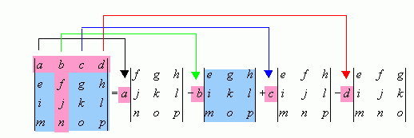
Determinant of a Matrix
Calculating the Determinant of a 4 x 4 Matrix
Notice the definition of determinant is inherently recursive:
The determinant of a $n x n$matrix is calculated from the determinants of $n$ reduced matrices of size $(n−1)×(n−1)$,
and so on and so on, getting down to simple 2 x 2 matrices

Slide 46
Determinant of a Matrix
Calculating the Determinant of a 4 x 4 Matrix
These smaller matrices, where a row and column has been removed, are called the cofactors of the original (larger) matrix
Notice the sign in front of each cofactor alternates from positive (+1) to negative (-1)

Slide 47
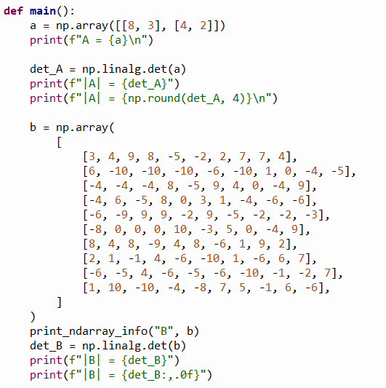
Open matrix_determinant.py
①
②
③
④
⑤
⑥
⑦
⑧

Slide 48
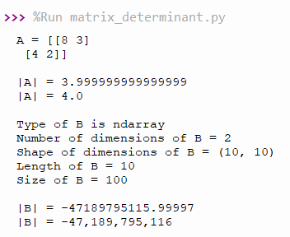
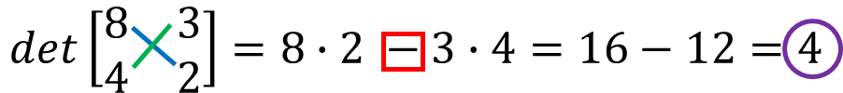


Run matrix_determinant.py
①
$$A=\left[\begin{matrix}8 & 3 \\ 4 & 2\end{matrix}\right]$$
②
$$\left|A\right|=4$$
③
④
⑤
⑥
Determinants can get quite large!

Slide 49
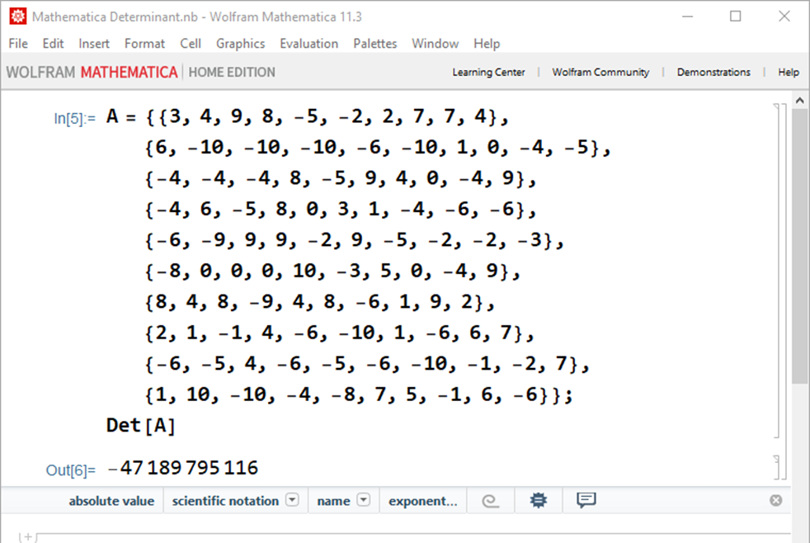
Determinant of a Matrix
Always seek independent confirmation!

Slide 50
Goal: Solve a System of Linear Equations
Two Equations and Two Unknowns
$$4x+7y=47$$
$$ax+by=c$$
$$a=4, b=7, c=47$$
$$3x−5y=−16$$
$$dx+ey=f$$
$$d=3,e=−5,f=−16$$
$$ax=c−by$$
$$\frac{d(c−by)}{a}+ey=f$$
$$x=\frac{c−by}{a}$$
$$cd−bdy+aey=af$$
$$y\left(ae−bd\right)=af−cd$$
$$y=\frac{\left(4\right)\left(−16\right)−(47)(3)}{\left(4\right)\left(−5\right)−(7)(3)}=\frac{−205}{−41}=5$$
$$y=\frac{af−cd}{ae−bd}$$

Slide 51
Goal: Solve a System of Linear Equations
Two Equations and Two Unknowns
$$4x+7y=47$$
$$ax+by=c$$
$$a=4, b=7, c=47$$
$$3x−5y=−16$$
$$dx+ey=f$$
$$d=3,e=−5,f=−16$$
$$by=c−ax$$
$$dx+\frac{e(c−ax)}{b}=f$$
$$y=\frac{c−ax}{b}$$
$$bdx+ce−aex=bf$$
$$x\left(bd−ae\right)=bf−ce$$
$$x=\frac{\left(47\right)\left(−5\right)−(7)(−16)}{\left(4\right)\left(−5\right)−(7)(3)}=\frac{−123}{−41}=3$$
$$x=\frac{bf−ce}{bd−ae}\left(\frac{−1}{−1}\right)=\frac{ce−bf}{ae−bd}$$

Slide 52
Goal: Solve a System of Linear Equations
Two Equations and Two Unknowns
$$4x+7y=47$$
$$ax+by=c$$
$$a=4, b=7, c=47$$
$$3x−5y=−16$$
$$dx+ey=f$$
$$d=3,e=−5,f=−16$$
$$x=\frac{ce−bf}{ae−bd}$$
$$y=\frac{af−cd}{ae−bd}$$
$$\det{C=\left|\begin{matrix}a & b \\ d & e\end{matrix}\right|=ae−bd}$$
$$\left|C\right|=\left(4\right)\left(−5\right)−\left(7\right)\left(3\right)=−41$$

Slide 53
Goal: Solve a System of Linear Equations
Two Equations and Two Unknowns
$$ax+by=c$$
Overlay the x coefficients with the RHS values
$$dx+ey=f$$
$$\det{A=\left|\begin{matrix}c & b \\ f & e\end{matrix}\right|=ce−bf}$$
$$x=\frac{ce−bf}{ae−bd}$$
$$y=\frac{af−cd}{ae−bd}$$
$$\det{C=\left|\begin{matrix}a & b \\ d & e\end{matrix}\right|=ae−bd}$$
$$\left|A\right|=\left(47\right)\left(−5\right)−\left(7\right)\left(−16\right)=−123$$
$$\left|C\right|=\left(4\right)\left(−5\right)−\left(7\right)\left(3\right)=−41$$

Slide 54
Goal: Solve a System of Linear Equations
Two Equations and Two Unknowns
$$ax+by=c$$
Overlay the y coefficients with the RHS values
$$dx+ey=f$$
$$\det{A=\left|\begin{matrix}c & b \\ f & e\end{matrix}\right|=ce−bf}$$
$$x=\frac{ce−bf}{ae−bd}$$
$$\det{B=\left|\begin{matrix}a & c \\ d & f\end{matrix}\right|=af−cd}$$
$$y=\frac{af−cd}{ae−bd}$$
$$\det{C=\left|\begin{matrix}a & b \\ d & e\end{matrix}\right|=ae−bd}$$
$$\left|A\right|=\left(47\right)\left(−5\right)−\left(7\right)\left(−16\right)=−123$$
$$\left|B\right|=\left(4\right)\left(−16\right)−\left(47\right)\left(3\right)=−205$$
$$\left|C\right|=\left(4\right)\left(−5\right)−\left(7\right)\left(3\right)=−41$$

Slide 55
Goal: Solve a System of Linear Equations
Two Equations and Two Unknowns
$$4(3)+7(5)=47$$
$$ax+by=c$$
$$3(3)−5(5)=−16$$
$$dx+ey=f$$
$$\det{A=\left|\begin{matrix}c & b \\ f & e\end{matrix}\right|=ce−bf}$$
$$x=\frac{ce−bf}{ae−bd}$$
$$x=\frac{\left|A\right|}{\left|C\right|}$$
$$\det{B=\left|\begin{matrix}a & c \\ d & f\end{matrix}\right|=af−cd}$$
$$y=\frac{af−cd}{ae−bd}$$
$$y=\frac{\left|B\right|}{\left|C\right|}$$
$$\det{C=\left|\begin{matrix}a & b \\ d & e\end{matrix}\right|=ae−bd}$$
$$x=\frac{\left|A\right|}{\left|C\right|}=\frac{−123}{−41}=3$$
$$\left|A\right|=\left(47\right)\left(−5\right)−\left(7\right)\left(−16\right)=−123$$
$$\left|B\right|=\left(4\right)\left(−16\right)−\left(47\right)\left(3\right)=−205$$
$$y=\frac{\left|B\right|}{\left|C\right|}=\frac{−205}{−41}=5$$
$$\left|C\right|=\left(4\right)\left(−5\right)−\left(7\right)\left(3\right)=−41$$

Slide 56
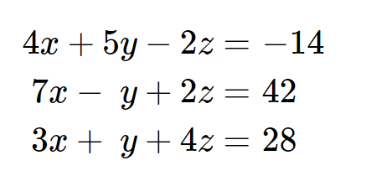
Goal: Solve a System of Linear Equations
Three Equations and Three Unknowns

Slide 57
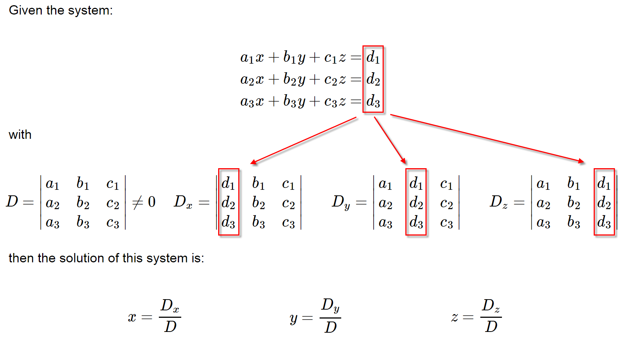
Cramer’s Rule
Second, we create an additional overlay matrix for each unknown
First, we create a matrix from the unknown coefficients

Slide 58
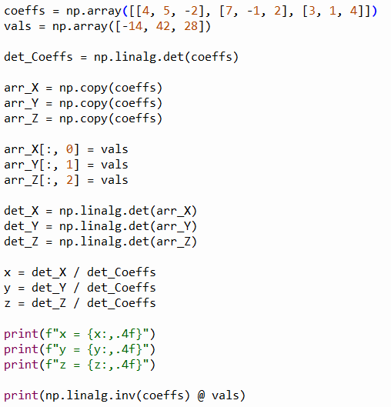
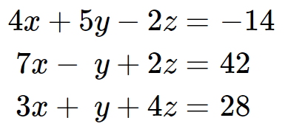

Open solve_3x3.py
①
②
③
④
Overlay the values vector over the top of each column in the coefficients vector
⑤
⑥
⑦
⑧
$$x=A^{−1}⋅B$$
⑨

Slide 59
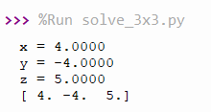




Run solve_3x3.py
$$x=A^{−1}⋅B$$
$$4\left(4\right)+5\left(−4\right)−2\left(5\right)=−14$$
$$7\left(4\right)−\left(−4\right)+2\left(5\right)=42$$
$$3\left(4\right)+\left(−4\right)+4\left(5\right)=28$$

Slide 60
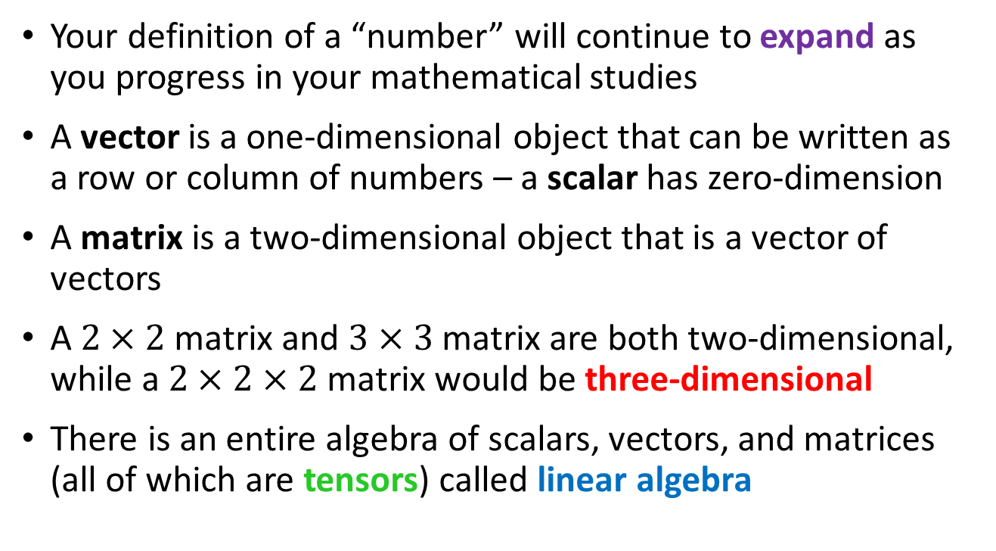
Session 16 – Now You Know…
Your definition of a “number” will continue to expand as you progress in your mathematical studies
A vector is a one-dimensional object that can be written as a row or column of numbers – a scalar has zero-dimension
A matrix is a two-dimensional object that is a vector of vectors
A $2×2$ matrix and $3×3$ matrix are both two-dimensional, while a $2×2×2$ matrix would be three-dimensional
There is an entire algebra of scalars, vectors, and matrices (all of which are tensors) called linear algebra

Slide 61
Session 16 – Now You Know…
The dot product produces a scalar and, in 2-dimensional Cartesian space, is the “angle” between two vectors
There is an algorithm for multiplying two matrices, but they must have compatible shapes
Much like we can take the reciprocal of a scalar, we can take the inverse of a matrix to help solve equations
The determinant of a matrix is a scalar and indicates if its matrix is invertible and how that matrix will transform space
Using Cramer’s Rule, we can solve systems of linear equations in parallel on multiple computer units (CPU or GPU cores) at the same time

Slide 62
Task 16
Update the Python program solve_4x4.py to solve the following system of linear equations:
$$x_{1}+2x_{2}+x_{3}−x_{4}=5$$
$${3x}_{1}+2x_{2}+4x_{3}+4x_{4}=16$$
$$4x_{1}+4x_{2}+3x_{3}+4x_{4}=22$$
$$2x_{1}+x_{3}+5x_{4}=15$$

